Slide 1
Massively Parallel Sort-Merge Joins (MPSM) in Main Memory Multi-Core Database Systems
Martina Albutiu, Alfons Kemper, and Thomas Neumann Technische Universität München

Slide 2
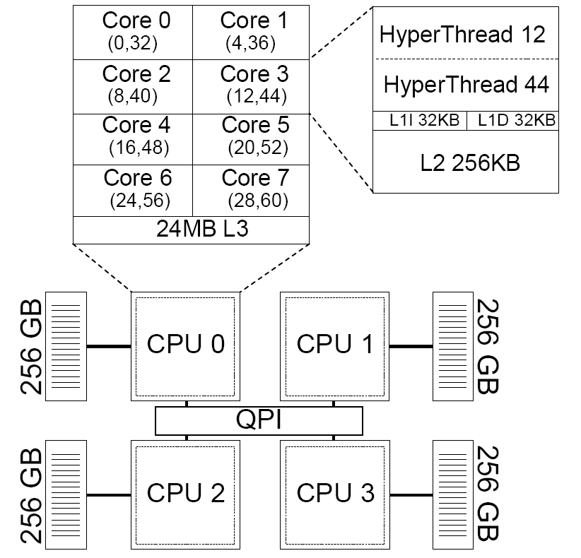
Hardware trends …
Huge main memory
Massive processing parallelism
Non-uniform Memory Access (NUMA)
Our server:
4 CPUs
32 cores
1 TB RAM
4 NUMA partitions
CPU 0
Notes:
Today‘s hardware follows two trends: huge main memory capacities and highly parallel multi-core processing. A good example is our new server HyPer1. It has 4 CPUs with 8 physical cores each, which results in a total of 32 cores, and 1 TB of RAM which is divided into 4 NUMA partitions.

Slide 3
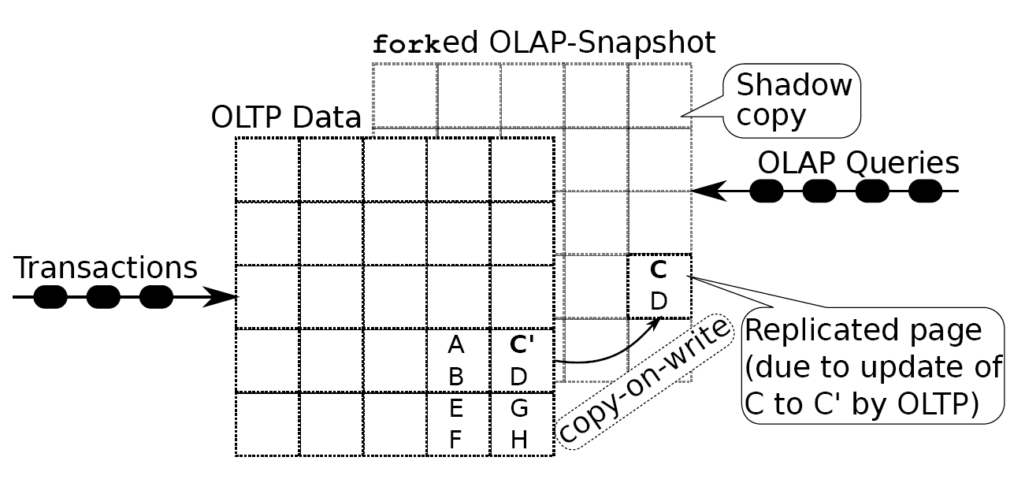
Main memory database systems
VoltDB, Hana, MonetDB
HyPer: real-time business intelligence queries on transactional data*
* http://www-db.in.tum.de/research/projects/HyPer/

Slide 4
How to exploit these hardware trends?
Parallelize algorithms
Exploit fast main memory access
→ Kim, Sedlar, Chhugani: Sort vs. Hash Revisited: Fast Join Implementation on Modern Multi-Core CPUs. VLDB‘09
→ Blanas, Li, Patel: Design and Evaluation of Main Memory Hash Join Algorithms for Multi-core CPUs. SIGMOD‘11
AND be aware of fast local vs. slow remote NUMA access
Notes:
For join processing this means that in order to exploit what modern hardware offers we need to parallelize algorithms and exploit fast main memory access. This has already been done in several works, for instance by Kim et al. who developed parallel sort and hash based join algorithms for main memory systems and by Blanas et al. who presented several variants of parallel hash join.
However, we didn‘t find any work that also took into account non-uniform memory access, that is that some memory partitions can be accessed faster than others, and we believe this is an important point to look at

Slide 5
Ignoring NUMA
NUMA partition 1
NUMA partition 3
core 1
core 5
hashable
core 2
core 6
NUMA partition 2
NUMA partition 4
core 3
core 7
core 4
core 8

Slide 6
How much difference does NUMA make?
100%
22756 ms
417344 ms
1000 ms
837 ms
scaled execution time
7440 ms
12946 ms
remote
local
remote
local
synchronized
sequential
merge join (sequential read)
sort
partitioning
Notes:
Before designing our join algorithm, we wanted to find out what effect certain optimizations for modern hardware have on the performance of some critical operations.
In our first microbenchmark we compared the performance of sorting on local and remote memory. We created an array of 1.6 bio tuples of 16 bytes each which is a total of 25GB. Then we chunked the array and let 32 parallel threads sort their chunk. In the red experiment the array was allocated globally, in the green experiment, the chunks were all local to their core. We overserve a performance penalty of a factor of three when the sorting was done in remote memory and therefore conclude that operations like sorting should be executed in local memory.
In the second microbenchmark we compared radix partitioning with and without synchronization between threads. In the red experiment we determined the next write position within the target partition using a test-and-set synchronized index variable. It took more than 400 seconds until the last thread finished partitioning. In the green experiment each thread pre-computed the sub-partitions and then wrote them sequentially without synchronization. The complete process takes about 13 seconds. Thus the synchronization penalty is about a factor of 30. This experiment reveals that even wait-free test-and-set synchronization between threads should be avoided whenever possible.
The third microbenchmark compares the performance of sequential scans of local and remote data. Therefore, each of the 32 threads merge joins two chunks of 50 mio tuples each. In the yellow experiment, one of the inputs is in local memory and one is remote, whereas in the green experiment both inputs are in local memory. With both inputs locally, the merge join is slightly faster, however, the difference is not significant. This is because the hardware prefetcher hides the latency incurred by accessing the remote memory. We thus conclude that sequential scans of remote memory have acceptable performance.

Slide 7

The three NUMA commandments
C2
Thou shalt read thy neighbor‘s memory only sequentially -- let the prefetcher hide the remote access latency.
C3
Thou shalt not wait for thy neighbors -- don‘t use fine-grained latching or locking and avoid synchronization points of parallel threads.
C1
Thou shalt not write thy neighbor‘s memory randomly -- chunk the data, redistribute, and then sort/work on your data locally.
Notes:
From the microbenchmark conclusions we derive the following three rules or commandments for algorithms on modern hardware:
Instead of accessing remote memory randomly, data should be chunked, redistributed and then processed locally.
When remote memory is accessed this should happen only sequentially.
Synchronization between threads has to be avoided!

Slide 8
Basic idea of MPSM
R
chunk R
R chunks
S chunks
S
chunk S
Notes:
In the design of MPSM we considered the commandments: To compute the join between a smaller relation R and a larger relation S, we first chunk both inputs.

Slide 9

Basic idea of MPSM
C1: Work locally: sort
C3: Work independently: sort and merge join
C2: Access neighbor‘s data only sequentially
chunk R
R chunks
sort R chunks locally
MJ
MJ
MJ
MJ
merge join chunks
S chunks
sort S chunks locally
chunk S
Notes:
Then each worker sorts its local chunk of R and S which corresponds to commandment one. Finally, each thread merge joins its sorted run of input R with all sorted runs of input S. Thereby, the local R run is read several times which is not critical as it is the smaller one and it is in local memory. We call R the private input as each thread only works on its local R chunk. S is the public input and which each thread reads completely. There is no synchronization during the sort phases or during the merge join phase, so that commandment three is fulfilled. Further, during merge join remote memory is accessed only sequentially, so that commandment two is also met.

Slide 10
Range partitioning of private input R
To constrain merge join work
To provide scalability in the number of parallel workers
Notes:
This basic MPSM algorithm requires scanning the complete larger input S. In order to contrain merge join work and to provide scalability in the number of parallel workers, we range partition the private input.

Slide 11
Range partitioning of private input R
To constrain merge join work
To provide scalability in the number of parallel workers
R chunks
range partition R
range partitioned R chunks
Notes:
For example, if there are four workers that have been assigned these R chunks and white parts denote small key values and darker parts larger key values, the R data is redistributed among the workers so that each worker obtains a disjoint key set. The first worker gets the smallest white keys, the second the larger light blue keys, and so on.

Slide 12
Range partitioning of private input R
To constrain merge join work
To provide scalability in the number of parallel workers
→ S is implicitly partitioned
range partitioned R chunks
sort R chunks
S chunks
sort S chunks

Slide 13
Range partitioning of private input R
To constrain merge join work
To provide scalability in the number of parallel workers
→ S is implicitly partitioned
range partitioned R chunks
sort R chunks
MJ
MJ
MJ
MJ
merge join only relevant parts
S chunks
sort S chunks
Notes:
By partitioning the private input, the public input S is implicitly partitioned as each R chunk now only joins with a fraction of each S chunk.

Slide 14
Range partitioning of private input
Time efficient
branch-free
comparison-free
synchronization-free
and
Space efficient
→ densely packed
in-place
by using radix-clustering and precomputed target partitions to scatter data to
Notes:
The range partitioning is designed branch-free, comparsion-free, and synchronization-free. Therefore, we use radix-clustering and precompute the target sub-partitions to which each worker scatters its data.

Slide 15
Range partitioning of private input
histogram of worker W₁
prefix sum of worker W₁
19=10011
19
19
9
<16
W₁
7 = 00111
4
0
7
≥16
→1
chunk of worker W₁
3
0
3
21
21
17 = 10001
2
1
W₂
17
17
2=00010
histogram of worker W₂
prefix sum of worker W₂
2
19
23
W₁
23
<16
→5
3
4
4
≥16
chunk of worker W₂
4
3
31
31
8
W₂
20
20
26
26
Notes:
Let me show you how it works using this example. There are two workers, each of them has a private input chunk of size 7. The key domain is from 0 to 31. We need to create two partitions so we take the first bit of the key to decide to which partition to scatter a tuple. This results in all keys smaller than 16 to be placed in the first partition and all keys between 16 and 31 in the second.
Instead of just copying the tuples to their new partition which would incur synchronization overhead, we precompute the target positions of the tuples. In a first pass through the data each thread computes a histogram stating how many of its tuples fall into which partition. Here again we use the first bit of each key as an index into the histogram. In our example four tuples of the first chunk fall into the first partition and three in to the second. From the second chunk three tuples belong to the first target partition and four to the second. Out of these histograms, each thread then computes prefix sums which denote the starting addresses within the target partitions. In our example, worker W1 begins writing at position 0 within the first and the second target partition. Worker W2 starts writing at position 4 within the first target partition as worker W1 scatters 4 tuples to this partition. Within the second partition, workers W2 begins writing at position 3 because the first three positions belong to worker W1.
This way, the two workers write to distinct positions within the target partitions and don‘t require any kind of synchronization. Each worker scatters its tuples according to its prefix sum and updates its prefix sum accordingly.
For example, the first tuple with key 19 belongs to the second partition. Workers W1 checks the second bucket of its prefix sum, updates the position and writes the tuple to the first position of the second partition. After all tuples have been scattered, the result looks like this.

Slide 16
Range partitioning of private input
histogram of worker W₁
prefix sum of worker W₁
19=10011
19
9
9
<16
W₁
7
7 = 00111
4
0
7
≥16
→1
3
chunk of worker W₁
3
0
3
1
21
17 = 10001
2
1
W₂
4
17
8
2=00010
histogram of worker W₂
prefix sum of worker W₂
2
19
23
W₁
21
<16
→5
3
4
4
≥16
17
chunk of worker W₂
4
3
31
23
8
W₂
31
20
20
26
26
Notes:
Radix partitioning bears some risks in case of skew. For uniform data, it is ok to use static partition bounds like we did it in the example. But if the data is skewed, this can result in totally different chunk sizes and thus unbalanced loads of the threads.

Slide 17
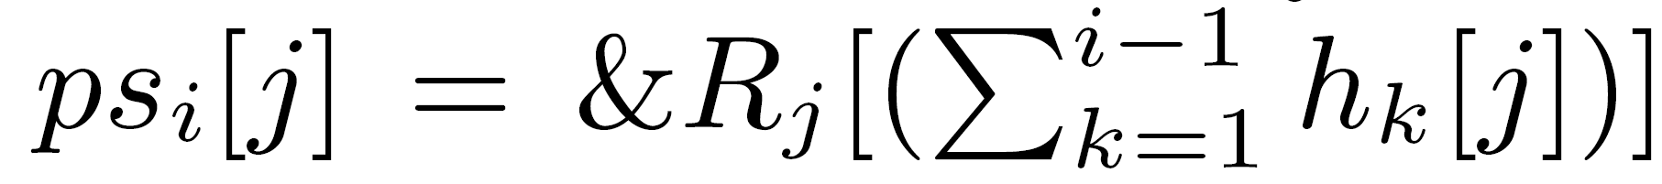
Real C hacker at work …

Slide 18
Skew resilience of MPSM
Location skew is implicitly handled
Distribution skew:
Dynamically computed partition bounds
Determined based on the global data distributions of R and S
Cost balancing for sorting R and joining R and S

Slide 19
Skew resilience
1. Global S data distribution
Local equi-height histograms (for free)
Combined to CDF
CDF
1
2
# tuples
7
12
16
10
17
15
25
13
22
33
31
42
66
78
81
90
S₁
S₂
50
key value

Slide 20
Skew resilience
2. Global R data distribution
Local equi-width histograms as before
More fine-grained histograms
2
histogram
13
2 = 00010
13
<8
4
3
2
[8,16)
31
31
8 = 01000
[16,24)
8
1
8
≥24
20
1
20
6
R₁

Slide 21
Skew resilience
3. Compute splitters so that overall workloads are balanced*: greedily combine buckets, thereby balancing the costs of each thread for sorting R and joining R and S are balanced
CDF
# tuples
histogram
2
+
3
=
4
2
6
1
13
1
31
8
key value
20
* Ross and Cieslewicz: Optimal Splitters for Database Partitioning with Size Bounds. ICDT‘09

Slide 22
Performance evaluation
MPSM performance in a nutshell:
160 mio tuples joined per second
27 bio tuples joined in less than 3 minutes
scales linearly with the number of cores
Platform HyPer1:
Linux server
1 TB RAM
4 CPUs with 8 physical cores each
Benchmark:
Join tables R and S with schema {[joinkey: 64bit, payload: 64bit]}
Dataset sizes ranging from 50GB to 400GB

Slide 23
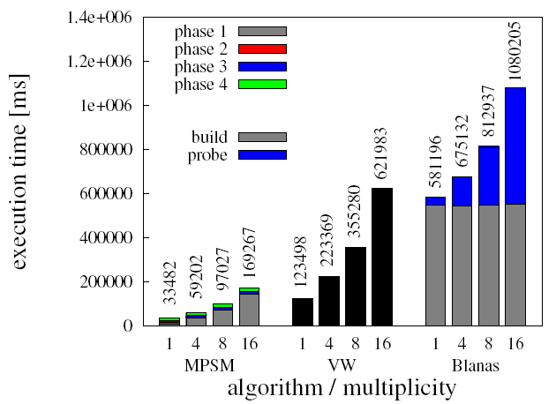
Execution time comparison
MPSM, Vectorwise (VW), and Blanas hash join*
32 workers
|R| = 1600 mio (25 GB), varying size of S
* S. Blanas, Y. Li, and J. M. Patel: Design and Evaluation of Main Memory Hash Join Algorithms for Multi-core CPUs. SIGMOD 2011

Slide 24
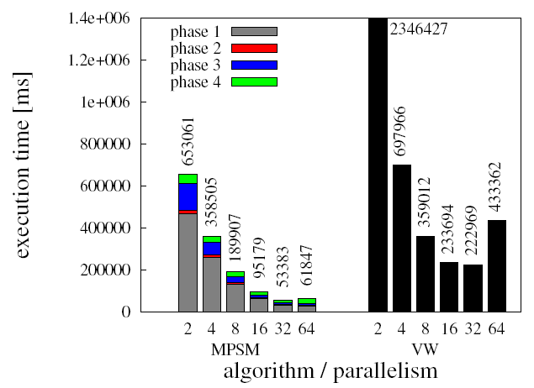
Scalability in the number of cores
MPSM and Vectorwise (VW)
|R| = 1600 mio (25 GB), |S|=4*|R|

Slide 25
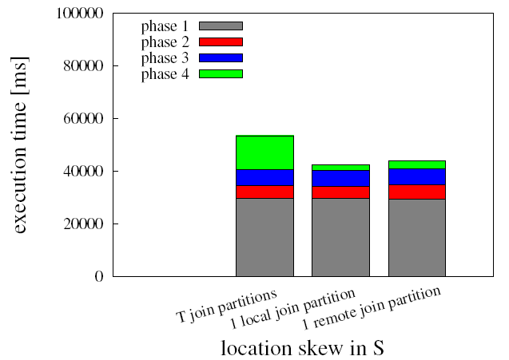
Location skew
Location skew in R has no effect because of repartitioning
Location skew in S: in the extreme case all join partners of R_{i} are found in only one S_{j} (either local or remote)

Slide 26
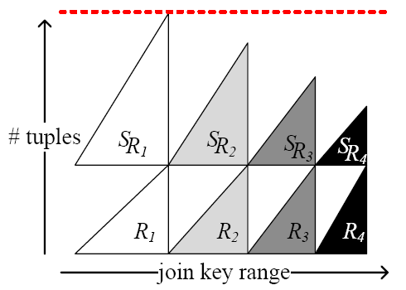
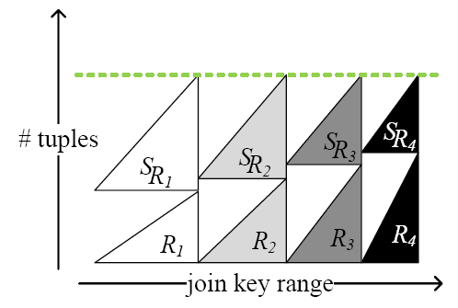
Distribution skew: anti-correlated data
without balanced partitioning with balanced partitioning
Notes:
In the last experiment we fixed the cardinality of R to be 1.6 billion tuples and S to be four times as large. We then created data sets with negative correlation to demonstrate the effect of cost balanced partitioning. For R 80% of the join keys were generated at the 20% high end of the domain and for S 80% of the joink eys were generated at the low 20% end of the domain.
On the left side we show the effect of partitioning R into equal-cadinality partitions. Thereby we have wider ranges on the left and narrower ranges on the right. Because of the negative correlation the corresponding S partitions are very unbalanced. On the right the partitioning takes into account balanced workloads instead of balanced R chunk sizes.

Slide 27
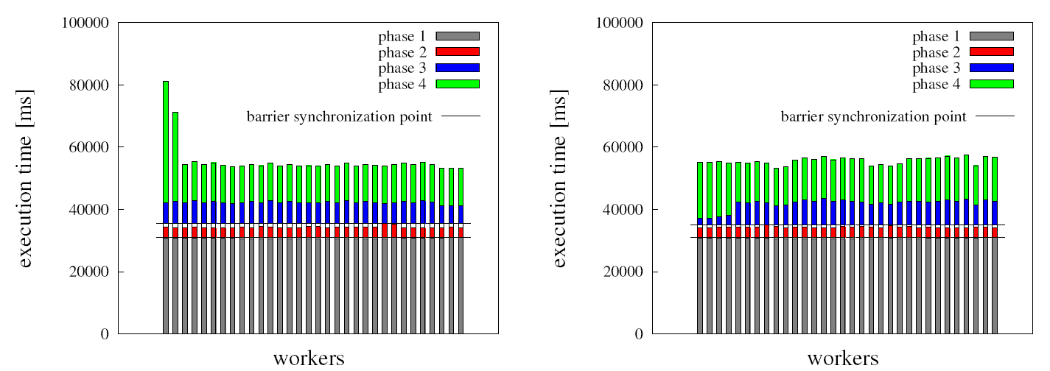
Distribution skew : anti-correlated data
Notes:
When partitioning into equally sized R chunks we see that the costs for sorting R (blue, phase 3) are balanced but the merge join costs are not. On the right we see that when we balance the costs for sorting R and for merge joining R and S, the left threads have much smaller sorting execution time for R but the overall join execution time is balanced over the workers.

Slide 28
Conclusions
MPSM is a sort-based parallel join algorithm
MPSM is NUMA-aware & NUMA-oblivious
MPSM is space efficient (works in-place)
MPSM scales linearly in the number of cores
MPSM is skew resilient
MPSM outperforms Vectorwise (4X) and Blanas et al‘s hash join (18X)
MPSM is adaptable for disk-based processing
See details in paper

Slide 29
Massively Parallel Sort-Merge Joins (MPSM) in Main Memory Multi-Core Database Systems
Martina Albutiu, Alfons Kemper, and Thomas Neumann Technische Universität München THANK YOU FOR YOUR ATTENTION!

